Slide 1
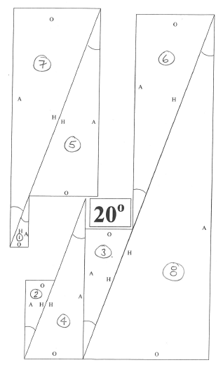
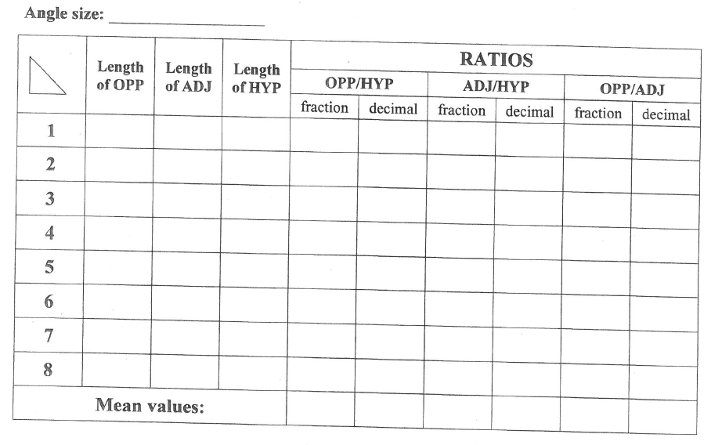
Working in pairs fill in the table using 1 set of triangles all with the same angle size.
Label the sides of your 8 triangles
Measure the sides and complete columns 1,2 and 3 of the table
Use the trig ratios to work out the fraction
Use a calculator to work out the decimal
Write your names on top – you will need this information for the validation.

